Slide 1

AI-Assisted
Requirements
& Test Design
Advanced QA Engineering
48 hours | 6 units
Notes:
Introduce the course as a test-design program. AI supports analysis and drafting, while the team remains accountable for evidence and decisions.

Slide 2
Course agenda
01 | Requirement analysis and ambiguity detection
02 | Coverage gaps and requirement traceability
03 | Scenario generation and risk prioritization
04 | Detailed test cases and quality review
05 | Exploratory charters and checklists
06 | Test data, masking, and boundary datasets
Notes:
Explain that each unit receives eight hours. Every unit produces one reviewed artifact that feeds the capstone.

Slide 3

One continuous workflow
across six units
AI assistant
Extracts, compares, and drafts
Human reviewer
Validates, decides, and approves
Notes:
Frame the course around two complementary roles. Learners should never treat model output as test evidence or an approved product decision.

Slide 4
The course builds a source-backed test design package, from unclear requirements to privacy-safe test data.
AI expands review breadth
It proposes questions, links, scenarios, and drafts.
Humans protect correctness
They verify sources, risks, oracles, and data handling.
Notes:
Use this slide to set expectations. Speed matters only when the resulting artifacts remain correct, traceable, and reviewable.

Slide 5
Running case: omnichannel order and refund platform
System scope
Web and mobile clients connect to payment, inventory, discount, notification, and audit services.
Learning challenge
The source pack contains incomplete stories, conflicting rules, a change request, non-functional constraints, and unsafe data examples.
Notes:
Keep one case study across the course. Continuity makes traceability, change impact, and the final capstone more realistic.

Slide 6
AI workflow
1 Scope the task and exclusions
2 Ground the model with approved sources
3 Generate a small structured draft
4 Challenge assumptions and missing views
5 Verify rules, calculations, and evidence
6 Record the human decision and provenance
Notes:
Demonstrate this loop at the start of the course. Reuse it for requirement review, traceability, scenarios, cases, charters, and data.

Slide 7
Responsible AI working agreement
Every generated artifact remains a draft until a named reviewer approves it.
Protect production data, credentials, personal data, and proprietary material.
Separate facts, assumptions, questions, and suggestions.
Record the source set, prompt version, reviewer, and review result.
Use approved source material
Cite requirement or rule IDs
Write Not specified for gaps
Validate with deterministic checks
Keep a human approval trail
Notes:
Ask learners to challenge any workflow that uploads sensitive data or turns a model suggestion into an approved requirement without review.

Slide 8
Grounded output and unsafe output
Review rule
The model may analyze supplied facts and flag gaps. Missing behavior becomes a question, not an invented answer.
Grounded output
Requirement R-14 does not define retry limits. Ask the service owner.
Unsafe output
The service retries three times because that pattern is common.
Source citation
Explicit uncertainty
Human disposition
Invented behavior
False confidence
No evidence
Reviewer question: Can another person trace every material statement to evidence?
Notes:
Use the retry example to show a common hallucination pattern. Plausible behavior can still be wrong product behavior.

Slide 9
Course map
Six linked deliverables build one capstone package.
Stage | Focus | Hours | Primary output | Core validation
Unit 1 | Requirements | 8 | Quality report | Source fidelity
Unit 2 | Coverage | 8 | Traceability pack | Behavior-level links
Unit 3 | Scenarios | 8 | Risk portfolio | Design rationale
Unit 4 | Test cases | 8 | Reviewed suite | Observable oracles
Unit 5 | Exploration | 8 | Charter pack | Evidence and learning
Unit 6 | Test data | 8 | Data package | Data privacy
Capstone | Integration | Included | End-to-end package | Human defense
Notes:
Clarify that 100 percent linkage does not prove adequate coverage. Each unit adds a different type of evidence.

Slide 10
Learning pattern in every unit
Each eight-hour unit mixes concise theory with demonstration, guided practice, peer review, and an assessed deliverable.
Learn
Study the quality model and test-design technique.
Demonstrate
Compare weak and controlled AI workflows.
Practice
Apply the method to the running case.
Review
Defend decisions and record rejected suggestions.
Notes:
Keep lectures short. The course allocates most time to hands-on work and review because judgment improves through comparison and feedback.

Slide 11
Unit 1: Requirement testability
Specific and observable
Actors, triggers, outcomes, thresholds, and sources of truth are explicit.
Complete enough to test
Alternate flows, error behavior, permissions, and data lifecycle are visible.
Consistent across sources
Stories, rules, contracts, and quality attributes do not contradict one another.
Measured without invention
Missing values become clarification questions instead of model assumptions.
Notes:
Introduce specificity, observability, controllability, measurability, consistency, feasibility, and traceability as the review criteria.

Slide 12
Unit 1 workshop
Extract
Decompose actors, conditions, rules, outcomes, and exceptions.
Challenge
Classify ambiguity, missing rules, conflicts, and weak measures.
Refine
Rewrite acceptance criteria and preserve the original business intent.
Notes:
The chart uses illustrative workshop data. Deliverable: a requirement quality report with evidence, questions, proposed wording, assumptions, and rejected AI suggestions.

Slide 13
Unit 2: Traceability and coverage gaps
Goal
Build defensible links between requirements, risks, scenarios, tests, data, and execution evidence.
Key principle
Keyword similarity proposes a candidate link. Behavioral evidence confirms coverage.
Full, partial, indirect, none
Coverage status
Roles, states, rules, interfaces
Coverage dimensions
Duplicate, orphan, obsolete
Asset quality
Direct and indirect impact
Requirement change
Notes:
Explain why test-case count is a weak coverage measure. The analysis must include roles, states, combinations, interfaces, failures, and quality attributes.

Slide 14
Traceability chain
SOURCE
DESIGN
EVIDENCE
Requirement and risk
State the business behavior, quality expectation, and consequence of failure.
Scenario and test
Show which condition, variation, action, and oracle provide direct coverage.
Execution evidence
Connect the result, defect, environment, data version, and release decision.
Notes:
Deliverable: a reviewed traceability matrix, gap heatmap, orphan and duplicate list, plus a change-impact report.

Slide 15
Unit 3: Scenario generation
Requirements
Derive critical flows, validation, business rules, roles, and exception behavior.
Risks and history
Use impact, usage, defects, incidents, change complexity, and abuse cases.
Models and techniques
Apply boundaries, decision tables, states, pairwise coverage, and invariants.
INPUT 1
INPUT 2
INPUT 3
Notes:
AI can broaden the initial scenario set, but the tester must name the source and test-design technique behind each scenario family.

Slide 16
Risk prioritization
Worked example: priority score combines likelihood and business impact. Teams add exposure, detectability, or change factors only when the evidence supports them.
25
4
High-risk example
Likelihood 5 × impact 5
Lower-risk example
Likelihood 2 × impact 2
Notes:
The values are illustrative. The learning objective is transparent reasoning, not false mathematical precision. Learners also document residual risk for deferred scenarios.

Slide 17
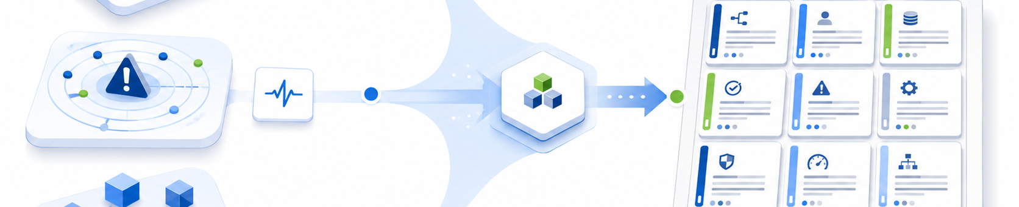
Unit 3 output: a balanced scenario portfolio
Behavior breadth
Positive, negative, alternate, state, timing, and recovery coverage.
Quality risks
Security, privacy, performance, reliability, usability, and accessibility.
Execution plan
Smoke, critical path, targeted regression, deep testing, and exploration.
Notes:
Deliverable: a scenario catalog with source references, techniques, risk scores, selected execution subsets, and documented residual risk.

Slide 18

Detailed test case anatomy
Preconditions
Known state, environment, role, and dependencies.
Test data
Purposeful values, constraints, IDs, and cleanup rules.
Actions
Precise behavior without brittle implementation detail.
Expected results
Observable, measurable, and source-backed oracles.
Notes:
Emphasize the oracle. A detailed test case fails quality review when another tester cannot observe and verify the expected result.

Slide 19
Unit 4: Test case quality review
AI drafts one case first. Human review confirms source alignment before the model expands a full family of cases.
Correctness
Requirement alignment, valid business rules, feasible setup, and no invented outcomes.
Maintainability
Independent execution, controlled data, clear cleanup, and limited duplication.
Diagnostic value
Strong checkpoints, observable oracles, and enough evidence to explain a failure.
Notes:
Deliverable: a reviewed detailed suite with traceability, data, cleanup, findings, automation recommendations, and an AI change log.

Slide 20
Exploratory session timeline
0–10 min | 10–25 min | 25–45 min | 45–55 min | 55–60 min
SETUP
LEARN AND MAP
DEEP EXPLORATION
FOLLOW-UP IDEAS
CAPTURE EVIDENCE
DEBRIEF
Notes:
A charter sets direction without prescribing every action. During the session, the tester learns, adapts, captures evidence, and proposes follow-up work.

Slide 21
Unit 5: Exploratory charter portfolio
Target | Persona | Data | Interface | Failure | Security | Recovery
Checkout | Guest | Boundary | Payment | Timeout | Abuse | Retry
Refund | Agent | Partial | Inventory | Stale state | Role | Rollback
Discount | Member | Locale | Pricing | Conflict | Tampering | Recalculate
Notice | Customer | Encoding | Email | Outage | Privacy | Resend
Audit | Admin | Retention | Log sink | Backlog | Access | Replay
CHARTER
CHARTER
CHARTER
CHARTER
CHARTER
CHARTER
CHARTER
CHARTER
CHARTER
CHARTER
CHARTER
CHARTER
CHARTER
Notes:
Use the matrix to choose focused charters, not to claim completeness. Deliverable: prioritized charters, concise checklists, session notes, evidence, questions, and a debrief.

Slide 22
Test data design matrix
Baseline | Boundary | Invalid | Stateful | Volume
Typical order | Min amount | Malformed ID | Created | Small batch
Known customer | Max quantity | Duplicate key | Paid | Peak batch
Valid refund | Expiry time | Broken reference | Refunded | Soak dataset
Standard locale | Precision | Unsafe string | Reversed | Recovery load
VERIFY
VERIFY
VERIFY
VERIFY
VERIFY
VERIFY
Notes:
Each row needs a purpose. Expected-valid records satisfy all constraints. Expected-invalid records should violate only the intended rule when practical.

Slide 23
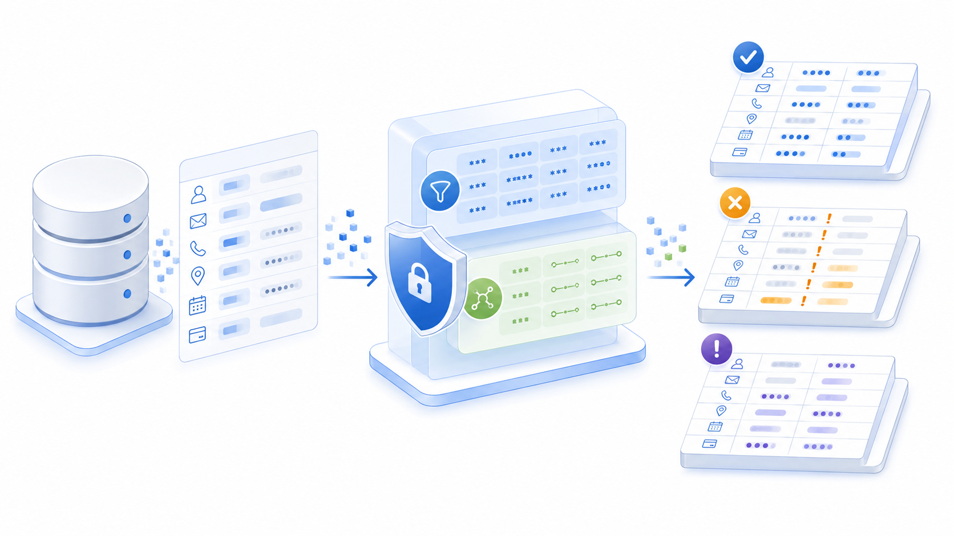
Unit 6: Privacy-safe test data
Classify
Identify direct identifiers, quasi-identifiers, secrets, and confidential business data.
Transform
Choose masking, substitution, tokenization, or fully synthetic generation.
Validate
Check constraints, referential integrity, leakage, provenance, setup, and cleanup.
Notes:
Deliverable: a versioned dataset package with schema, constraints, boundary and invalid records, masking decisions, validation evidence, seed, setup, and cleanup.

Slide 24
Capstone
One coherent, evidence-backed test design package
70% recommended pass mark
Notes:
Learners defend their requirement analysis, traceability, risk choices, detailed tests, exploratory assets, and privacy-safe data. A critical correctness or privacy failure prevents a passing result.

